Slide 1

HEALTHCARE PROJECT
Website: https://www.zivaskinclinic.com/
Location: India
BY
NITHYA K
Email ID: nithyanithukj@gmail.com

Slide 2
Channel Recommended:
Google ads
Facebook ads
Local SEO

Slide 3
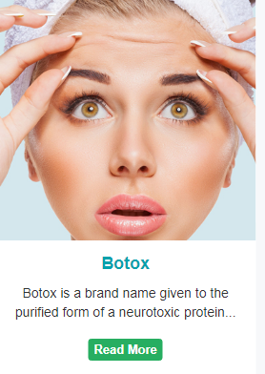
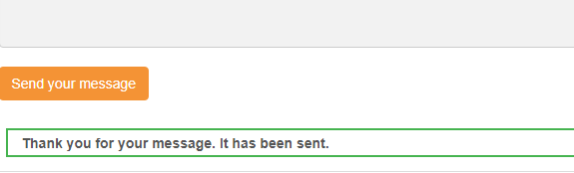
RECOMMENDED:
“Botox” is a restricted word by google. It is not authorized for promotion in google campaigns, so the word “Botox” is must be removed from the website.
2.
A Separate thank you page improves conversion tracking and provides a professional user experience and builds trust.
3. Privacy policy page: Privacy policy page is must for building trust with users. It is essential for ensuring transparency and protecting their data.

Slide 4
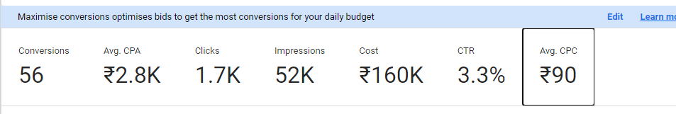
Google ads:
Daily Budget- 5000rp
Conversion Rate- 3.27%

Slide 5
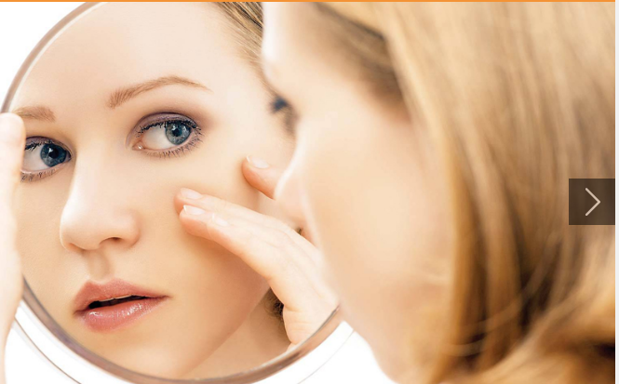
Landing Page:
Hero Section:
“Unlock Your Glow: Advanced Treatments for Flawless Skin!”
Resolve Your Skin Issues with our Professional Guidance
Name:
Email:
Phone:
Preferred Date:
Make an Appointment

Slide 6
2. About us:
Transform Your Skin at Ziva Skin Clinic:
At ziva skin clinic, We offer expert skincare treatments designed to enhance your natural beauty Our consultants with years of experience provide right professional advice to patients and patiently answers all their queries. We believe in giving sufficient time to each patient so that patients understand their disease and treatment properly. Our consultants are young and their enthusiasm to learn more and more is what make them excellent doctors. So, they keep themselves updated by attending all big conferences. We keep improving ourselves by taking suggestions from our patients.
3. Our services
Acne or Pimples
Chemical peeling
Dermal

Slide 7
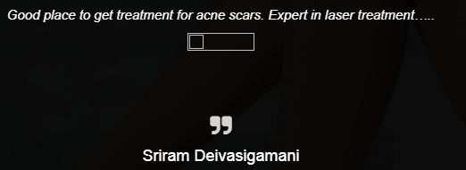
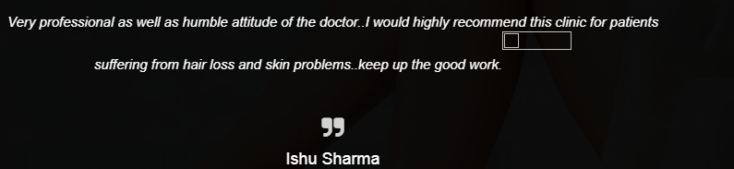
4. Testimonials
Our Clients Say

Slide 8
5. Contact Details
No. 370, 371, Cura Health Plus, IInd Floor, NSR Road, Saibaba Colony, opposite Dominos, Coimbatore, Tamil Nadu 641011, India
Shop no 10, Baba Sharvan Nath Market, Birla Mandir Chowk, Railway Station Aea, Thanesar, Haryana 136118, India
6. Footer Section
Links to Privacy Policy Page and Icons linking to business’s Social Media profiles

Slide 9
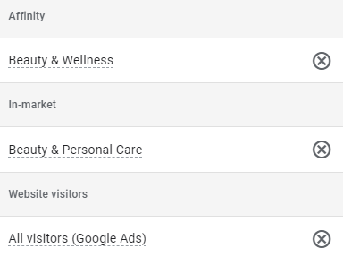
Campaign Objective
Sales (Because i want to bring my users to website for form submission)
Campaign Type
Search Campaign
Conversion Goal
Website visits, form submission
Location
India
Targeted Audience(category)

Slide 10
Match type
Exact Match
Final URL(Where people will go after clicking ad)
Landing page URL
Targeted Keyword
Skin care clinic
Dermatologist specialist
Skin specialist hospital
Best skin specialist doctor
Dermatologist best doctor
Best clinic for skin treatment
Best skin care clinic
Good skin doctor
Best skin specialist doctor
Skin hyper-pigmentation treatment

Slide 11
Ad Copy
Headline
Skin Specialist In Coimbatore
Laser & Anti-ageing Treatment
Best Skin Specialist
Dermatologist specialist
Consult For All Skin Diseases
Consult With Good Skin Doctor
Best Clinic For Skin Treatment
Make An Appointment
PGI Trained Doctors
Skincare Hospital, Call Now

Slide 12
Description
Make your appointment for effective treatments for all skin problems, Schedule Today.
Say Goodbye to Acne and Get a Glow Skin! Book an Appointment & Consult with our experts.
Worry about skin disease? Consult for all skin disease with our expert PGI Trained doctors
Restore your skin to its Natural Beauty, Schedule your skin consultation today!

Slide 13
Ad Extension
Site Link 1
Headline Laser tattoo removal
Description 1 Advanced Laser Tattoo Removal
Description 2 Safe & Precise Tattoo Removal
Final URL https://www.zivaskinclinic.com/laser-tattoo-removal/
Site Link 2
Headline Hydrating Skin Treatment
Description 1 Cleanses and hydrates the skin
Description 2 Improves skin texture and tone
Final URL https://www.zivaskinclinic.com/hydra-facial/
Site Link 3
Headline Laser Hair Reduction
Description 1 Advanced Laser Hair Removal
Description 2 Say Goodbye to Unwanted Hair
Final URL https://www.zivaskinclinic.com/laser-hair-reduction/

Slide 14
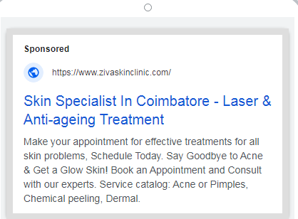
Site Link 4
Headline Browse Our Result Gallery
Description 1 See Our Stunning Treatment Results
Description 2 Before & After Treatment Photos
Final URL https://www.zivaskinclinic.com/gallery/#
Preview
Callouts
Call us excellent service
Trusted Experts
Structured Snippets
Acne or Pimples
Chemical peeling
Dermal

Slide 15
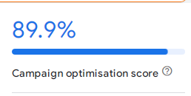
Budget Type : Daily budget
Budget Amount: 5000
Campaign Score

Slide 16
Google Tag Manager(GTM)
Google Tag Manager simplifies conversion tracking by allowing you to add and manage tags without editing site code. It tracks user actions like form submissions, clicks, and purchases through customizable triggers. GTM integrates easily with tools like Google Analytics for goal tracking and attribution. It also supports third-party tags like Facebook Pixel for multi-platform tracking. Form Submission is a direct conversion that we can see how many users accept our service.
Google analytics
Google analytics track conversions by measuring specific user action like form submission. It allows to set up goals to track KPIs on website. Analytics also provides detailed attribution insights, helping you understand which channels drive the most conversion.

Slide 17
Facebook ads

Slide 18
Ad
Ad name : Skin care clinic
Campaign : Traffic (I want bring audience to website)
Targeted audience:
Demographics
Age: 18-45
Gender: Female and male
Location: Coimbatore
Interest
Skincare, Beauty treatments and cosmetics. People who are Interested in shopping products like facial creams, serums, Anti-aging products and acne treatment. People who are interest in wellness, health, and fitness
Behaviour
People who have interacted with skincare-related content on Facebook or Instagram.Previous customers or website visitors.

Slide 19
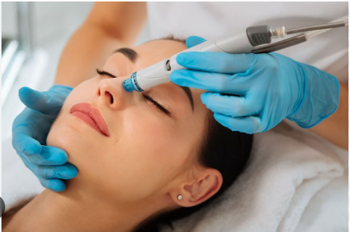
Image
Single image
Headline
Restore your skin to its natural beauty
Primary text
Say goodbye to acne, wrinkles, and dull skin with our personalized skincare treatments. Whether you’re looking for a rejuvenating facial, acne solutions, or anti-aging treatments, we’ve got you covered!
Book your free consultation today and start your journey to radiant, healthy skin.
Call to Action: visit website

Slide 20
Website URL: https://www.zivaskinclinic.com/?utm_source=facebook&utm_medium=FB+Ads&utm_campaign=skin+care+clinic
Benifits of UTM URL:
UTM URLs are used to track the performance of specific marketing campaigns by appending parameters to URLs, providing insights on traffic sources.

Slide 21
Local SEO

Slide 22
Targeted Keyword
Primary Keyword
Skin clinic coimbatore
Secondary Keyword
Nearest skin specialist
Skin doctor near by me
Near by skin clinic
Nearest skin specialist doctor
Good skin specialist near me
Nearest skin clinic
Nearby dermatologist doctor
Skin specialist in near me
Skin laser treatment near me

Slide 23
Business Name: Ziva Siva Clinic
Business Category: Skin care clinic
Business address: No. 370, 371, Cura Health Plus, IInd Floor, NSR Road, Saibaba Colony, opposite Dominos, Coimbatore, Tamil Nadu 641011, India
Services:
Acne or Pimples
Chemical peeling
Dermal
Opening hours
Monday 9am-10pm
Tuesday 9am-10pm
Wednesda 9am-10pm
Thursday 9am-10pm
Friday 9am-10pm
Saturday 9am-10pm

Slide 24
Description
we’re passionate about helping you achieve glowing, healthy skin. Specializing in [facials, skin treatments, anti-aging solutions, acne care, etc.], we use only the finest products and cutting-edge techniques to cater to your unique skin needs. Whether you’re looking to refresh your complexion, tackle specific skin concerns, or enjoy a relaxing spa experience, our team of licensed estheticians is here to guide you. Located in Coimbatore, we’re dedicated to providing personalized care and results-driven treatments that leave you feeling rejuvenated and confident. Book your appointment today and treat your skin to the care it deserves!"

Slide 25
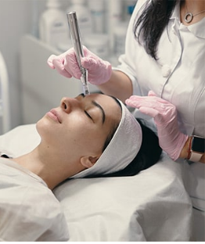
Service Images

Slide 26
Review section:
To maintain strong reputation we have to respond promptly and professionally to all reviews, both positive and negative ,to show you value customer input.
Schema markup:
Schema markup for local business enhance search engine visibility bu providing structured data about business such as location, hours, services.It helps improve local SEO

Slide 27
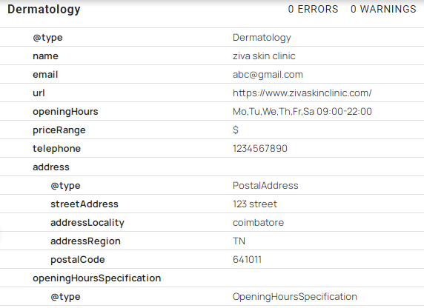
Local Business Schema

Slide 28
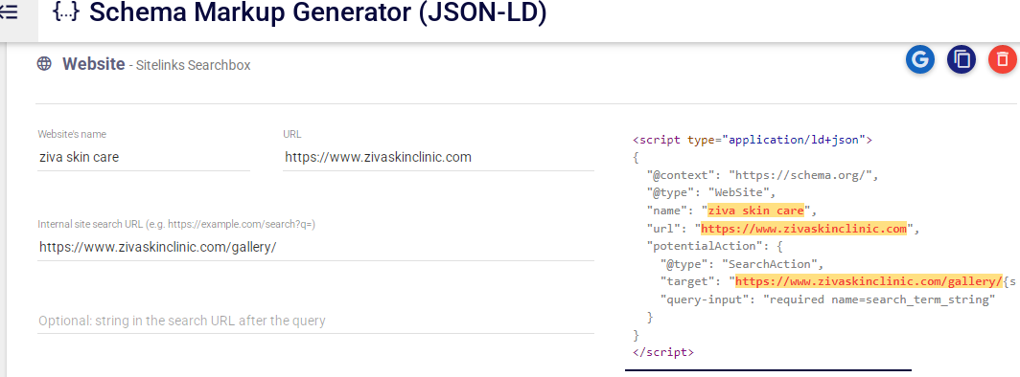
Website Schema

Slide 29
Backlinks :
How to select quality sites for backlinks?
The Domain authority should be higher than our website’s domain authority.
Qualified Interlinking sites.
Error free sites meaning there are no broken links
That site should have do follow links
Spam score should not be above 2%
Here some backlink sites:
Justdial and Practo profile link

Slide 30
Competitive Analysis

Slide 31
Competitor 1
Website : https://www.sriramakrishnahospital.com/
Domain authority : 36
SEO Score : 71 %
Total Backlinks : 118.5k
Organic Keywords : 37.7k
Est Monthly SEO Clicks: 54.9k
Page speed score : mobile-11 Desktop-81
Schema : Webpage, Medical Organization, LocalBusiness, BreadcrumbList,WebSite
Content analysis :
Usage of Local keyword Best hospital in Coimbatore done with 14 times.
Focusing on Local SEO which helps in improving their online presence.
Providing mobile app which helps to user friendly.
User ratings shown on website.
Proper call to action like book an appointment and consult now.
Testimonials added.
USP(User Selling Points) mentioned like 100+ modern equipment,etc.
A captivating website theme.

Slide 32
Competitor 2
Website : https://www.kevaclinic.com/
Domain authority : 9
SEO Score : 91%
Total Backlinks : 2k
Organic Keywords : 97
Est Monthly SEO Clicks : 203
Page speed score : Mobile-57 Desktop -74
Schema : Organization
Content analysis
Proper sticky header.
Properly added FAQ questions
Focusing on Local SEO
Updating blogs regularly

Slide 33
Competitor 3
Website : https://thereflectclinic.com/
Domain authority : 7
SEO Score : 61%
Total Backlinks : 29
Organic Keywords : 29
Est Monthly SEO Clicks : 107
Page speed score : Mobile-74 Desktop-91
Schema : No schema
Content analysis
A Proper call to action on every page
Testimonials added on the website

Slide 34
Competitor 4
Website : https://www.kaya.in/
Domain authority : 43
SEO Score : 12
Total Backlinks : 6.1k
Organic Keywords : 107
Est Monthly SEO Clicks : 452
Page speed score : Mobile-32 Desktop-48
Schema : Organization, Website
Content analysis :
A presented map direction that is easy for users to follow.
Included a Local keyword in the URL (dermatologist-near-me/coimbatore).
Usage of Local keyword Best hospital in Coimbatore done with 4 times that is focusing on Local SEO.
Social profiles linking.

